Slide 1
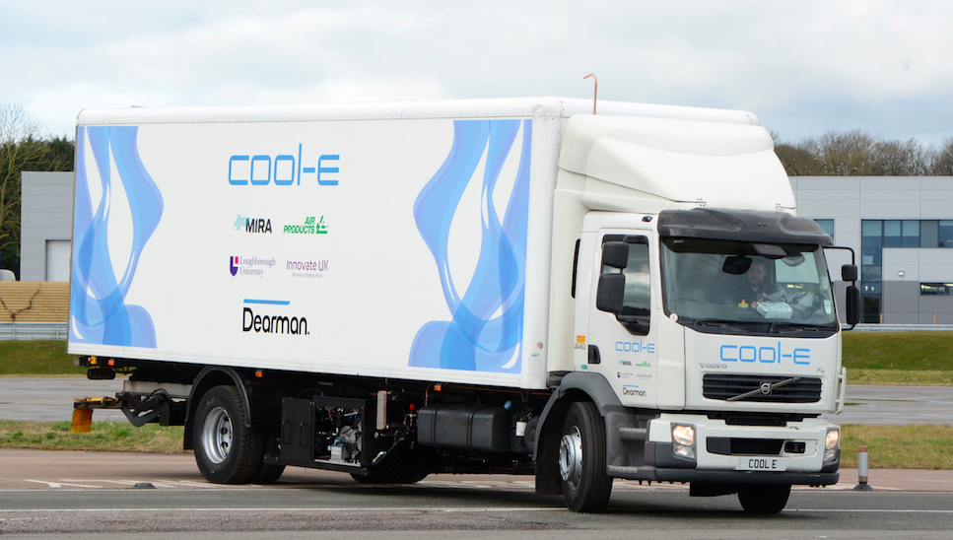
Doing Cold Smarter
Professor Toby Peters
Chair of Power and Cold Economy
Birmingham Energy Institute, University of Birmingham
co-Founder
Dearman Engine Company & Highview Power Storage

Slide 2
Storing Cold & Power
Our vision is to harness liquid air to deliver cleaner and cheaper transport and cooling globally.
In so doing we want to:
deliver environmental and economic benefit
help address the global challenges of food, energy and water, vital to global and local security and prosperity
transfer knowledge to and build capacity within emerging and developing economies

Slide 3
Why Cold Matters?
Europe is projected to see 70% increase in cooling demand over next 15 years.
Asian Pacific middle class could grow six-fold to 3.2 billion in 2030, two thirds of the global total, and its spending power could rise from $5 trillion to $33 trillion.
By 2050, 66 per cent of the world’s population is projected to be urban; adding 2.5 billion people to the world’s urban population by 2050.
In China cold chain logistics business to grow into a $60 billion industry at the rate of 25% annually;
E-commerce servicing consumer demand is a major the drivers of this growth.
India projects it needs to spend more than $15 billion
on its cold chain over the next five years.
The growth in global demand for all forms of
cooling to 2030 could equate 240GWs.
‘Doing Cold better’ is a global issue and a huge business
opportunity. 12-14M new TRUs could be needed to meet global demands.

Slide 4
Post-harvest Food Waste
49% of food is lost post-harvest
If developing countries had same level of cold chain as UK, they could save 200 million tonnes of perishable food.
Carbon emissions of food produced but not eaten is 3.3 billion tonnes; the third biggest emitter after the US and China
Water consumption of food wastage is 250km³; three times the volume of Lake Geneva
Demand for food is projected to grow by 40% by 2030. According to current trends India would be able to meet only 59% of its total food demand;
in East Asia, only 67% of the food demand will
be met from within the region.
In July 2014, the Institution of Mechanical Engineers recommended liquid air as the leading solution for clean and affordable cold and power.
Notes:
$4bn in Africa

Slide 5
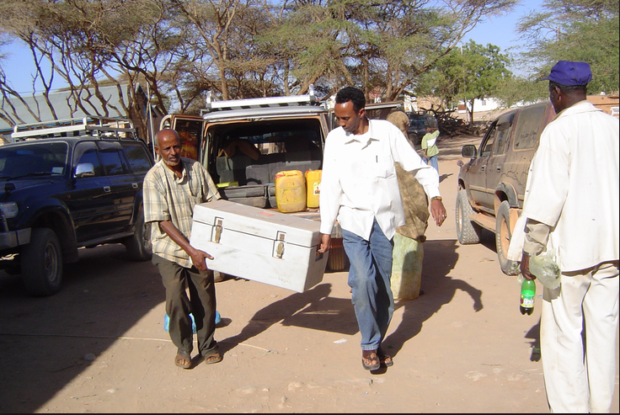
Vaccines and medicine losses
It is estimated that two million people die per year from lack of vaccines due to no cold chain.
India – the world’s third largest pharmaceutical
producer. Estimated 20% of temperature sensitive
healthcare products arrive damaged or degraded
because of a broken cold chain, including 25% of
vaccines.
Investment in pharmaceutical cold chains is growing
faster in Asia than any other region – up 50% to $1.5
billion in the five years to 2012 – but relies overwhelmingly on conventional technologies.
The industry is acutely aware of the need to develop sustainable cooling, but so far the focus has been on incremental improvements in the fuel efficiency of highly polluting diesel TRUs.

Slide 6
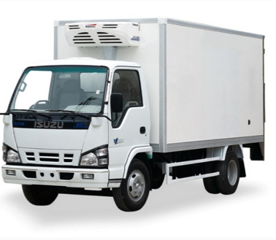
Cold Chain challenge – matching societal demands with the environmental impact
Emerging markets are seeing 25%+ growth
China projects it will need 365,000 cold chain vehicles by 2023, up from 30,000 in 2013
Global demand for cold in refrigeration and air conditioning is expected to grow significantly in the coming decades
Global commercial refrigeration equipment market to grow from $29Bn to $47Bn by 2018
A transport refrigeration unit:
consumes up to 20% of a refrigerated vehicle’s diesel
can emit up to 6x as much NOx and 29x as much PM of Euro VI engine
produces significant amounts of C0₂
uses HFC refrigerants
Notes:
2 million die each year from lack of cold chains for vaccines

Slide 7
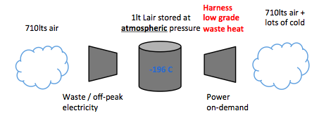
Why liquid air
We need to store renewable / waste energy to use on demand in grid or transport applications
Liquid air is about storing cold and power
Not a panacea, but a leapfrog solution linking renewable or wasted energy, including waste cold, to cooling, and power demands
Common operating principle for all technologies:
Energy generation side converts heat from the environment or a co-located process into shaft power
Air or nitrogen is the only exhaust
Opportunities for big synergies with processes that have cooling requirement or spare heat

Slide 8
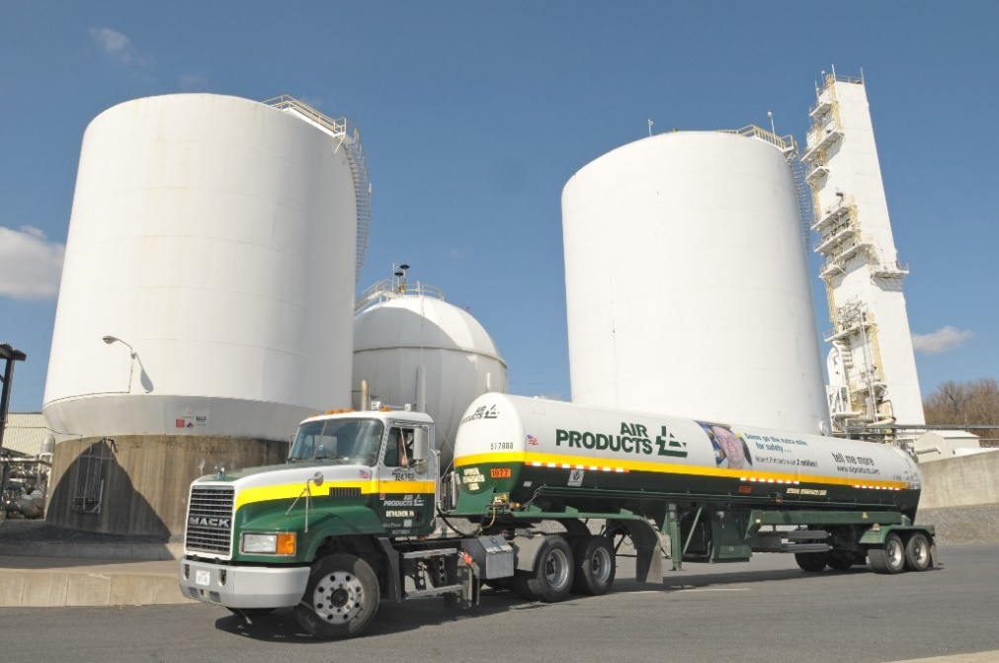
A mature process
A mature process present in every industrialised nation
2,000 tonnes of day of spare capacity in UK; 3,500 tonnes of spare capacity in India
Plants produce up to 1200 T/day of liquid product
Inputs are air and electricity.
Bulk storage available up to 1000s of tonnes
Rapid filling of liquids through pressure and pumped systems
Distribution is through pipeline or road tanker

Slide 9
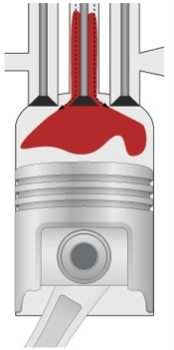
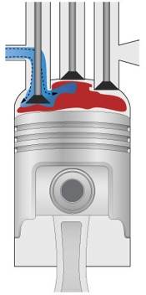
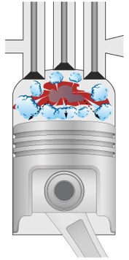
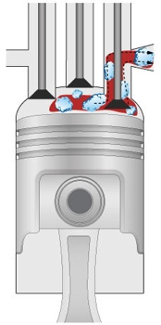
The Dearman engine
Process – Operates by boiling liquid air to produce high pressure gas that can be used to do work. Power + cooling
Inventive Step – Heat transfer inside the cylinder through direct contact heat exchange with a heat exchange fluid – patent granted
1.
2.
Return Stroke
Warm heat exchange fluid (HEF) enters the cylinder.
Top Dead Centre
Air injected - comes into contact with the HEF causes rapid temperature rise.
3.
4.
Rapid expansion
High pressurisation rates
Near isothermal expansion
Non combustive
Loads of cold
Power Stroke
The air expands pushing the piston down. Direct contact heat transfer continues allowing near isothermal expansion.
Bottom Dead Centre
The exhaust mixture leaves the cylinder. The gas is returned to the atmosphere and the HEF is re-heated and re-used.
Private and Confidential

Slide 10
Transport Refrigeration Application
Quick payback, better urban air quality, great CO₂ potential
On-vehicle demonstration with MIRA, Air Products and Loughborough University, funded by UK TSB, in commercial trials this summer
UK case | Vs Diesel
Yearly OpEx | -£1,200
CO₂ now/2030+ | -23%/-92%
Source: Analysis by E4tech / Dearman. Basis of 40ft frozen trailer with Euro 6 prime mover on a typical daily cycle; today’s average UK and NL grid carbon, and CCC 2030 target
Dearman system has zero emissions – Diesel APU can emit 6x as much NOx and 29x as much PM of the truck’s main engine
Private and Confidential

Slide 11
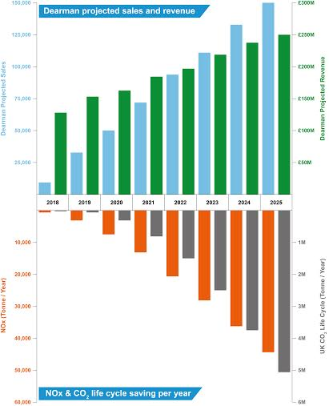
Dearman: economic and environmental dividend
By 2025 we expect to sell approximately 150,000 zero emission transport refrigeration units per year
Only 11% of the market, this will still deliver
approximately £250 million in annual revenue
savings of over 5 million tonnes of CO₂ per year will be equivalent to taking 132,000 Euro 6 diesel trucks off the road
The NOx saving will be equivalent to taking 3.4 million Euro 6 diesel trucks off the road

Slide 12
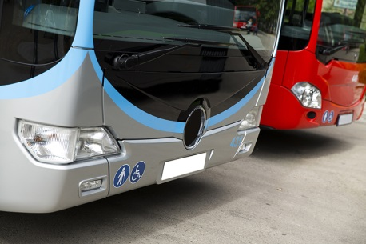
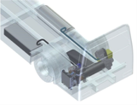
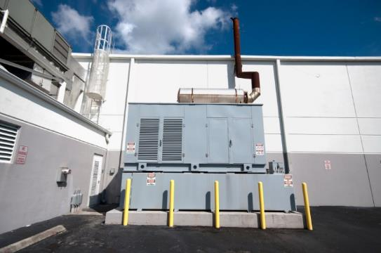
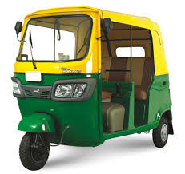
…and we have other products in development
Auxiliary power and air-conditioning
Engine waste heat recovery
Efficient cooling of bus/trucks
Particularly suited to warmer climates, where it could reduce fuel consumption by ~37%
Integrates with both conventional buses and the growing electric bus market
Projected payback of 6 months for buses
Recuperating waste energy from internal combustion engine of large vehicles to increase overall efficiency
Well suited to vehicles in frequent stop start operation e.g. buses
Payback of around 1.5 years in some duty cycles
Back-up power and energy services
Combined cooling and propulsion
Provision of zero emission cooling and back-up power and/or power-on-demand
Aimed at refrigerated buildings, data centres and supermarkets (sub 1MW market)
Payback of between 2 & 3 years without subsidy depending on usage patterns
Provision of primary power and cooling
Best suited to shorter range low-power cargo-vehicles especially last mile zero emission delivery vehicles & fork-lift trucks
Lower capex & whole-life cost than fuel cell or battery EV.

Slide 13
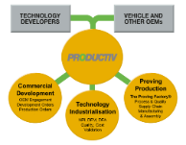
UK organisations working with Dearman
Subsystems development and support
Cryogenic systems and fuel Supplier
Techno-economics, planning and CPD
Manufacturing support
Advisor and support to simulation activities
Refrigeration market partner
Advisor and low temperature engineering
Advisor and assist on HEF reclaim and heat transfer
Project Partners
Advisor on lubrication and tribology (host test ops too)
Industrial advisors
Vehicle Integration Partner
End Users

Slide 14
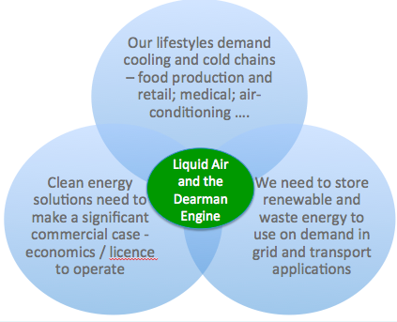
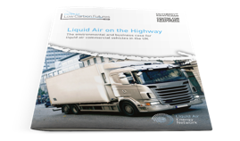
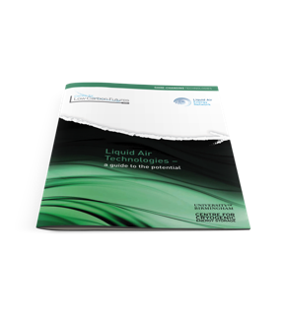
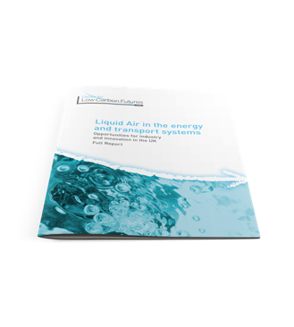
Marrying clean technology with a social purpose –
resulting in a high impact, high return investment.
Professor Toby Peters
Toby.peters@dearmanengine.com
+44 203 617 9170

